Slide 1



A Machine Learning-Based Framework for
Predicting Energy Consumption of
Neural Network Training
From Architectural and Configuration Features
MSc Computer Science | University of Ghana, Legon
Presented By: Vanessa Atta-Fynn

Slide 2
Presentation Outline
01
Background & Motivation
08
Data Sources
02
Problem Statement
09
Feature Engineering
03
Research Aim & Objectives
10
Model Development
04
Research Questions
11
Evaluation Strategy
05
Literature Review
12
Expected Contributions
06
Research Gap
13
Conclusion & Future Work
07
Methodology Overview

Slide 3
Background & Motivation
300,000x
24.7t
~945 TWh
Growth in AI
compute since 2012
CO₂ emitted training
BLOOM (176B params)
Projected data center
energy by 2030
The Red AI trend prioritizes accuracy through ever-larger models, making deep learning research increasingly inaccessible to researchers without massive compute budgets (Schwartz et al., 2020).
Source: Schwartz et al. (2020); Luccioni et al. (2023); IEA (2025)

Slide 4
Why This Research Matters
Who benefits from knowing energy costs before training?
Budget-Constrained Researchers
A student with limited Colab credits or a small AWS grant can compare architectures by predicted energy cost before committing resources. No more wasted credits on failed runs.
01
Architecture Designers
Instead of training 50 candidate models to find the most efficient one, designers can plot accuracy vs. predicted energy for all candidates instantly — turning months of experiments into minutes.
02
Organizations at Scale
Companies retraining models weekly can schedule training during off-peak hours, choose optimal hardware, and set energy budgets per project. At $100M+ training costs, even 10% savings is transformative.
03
Environmental Accountability
The EU AI Act and sustainability frameworks are pushing toward mandatory carbon disclosure. Our tool enables carbon budgeting before training — not just carbon receipts after the fact.
04

Slide 5
Problem Statement
Core Problem: No reliable method exists to predict how much energy a neural network training run will consume before it begins.
Measurement Tools
(CodeCarbon, Zeus)
Only work during/after
training — resources
already committed
Analytical Methods
(FLOPs, TDP)
Crude proxies that miss
memory, I/O, and
utilization factors
Existing Predictors
(NeuralPower)
Limited to specific
architectures & GPUs;
poor transferability
Software Accuracy
(Fischer, 2025)
Up to 40% error vs.
hardware-level
measurements

Slide 6
Research Aim & Objectives
AIM: To develop and evaluate an ML-based predictive framework for estimating energy consumption of neural network training from pre-training features.
O1
Identify architectural, hardware, and configuration features that influence training energy consumption
O2
Develop and compare ML regression models (Random Forest, XGBoost, Neural Network) for energy prediction
O3
Evaluate predictive accuracy and cross-architecture generalizability using MAE, RMSE, R², MAPE
O4
Assess whether ML-based prediction outperforms FLOP-based and TDP-based analytical baselines

Slide 7
Research Questions
RQ1
Which architectural, hardware, and configuration features are the strongest predictors of training energy consumption?
RQ2
How accurately can ML regression models predict energy consumption from pre-training features alone?
RQ3
To what extent do predictions generalize across different neural network architectures and hardware?
RQ4
Do ML-based predictions outperform traditional FLOP-based and TDP-based estimation methods?

Slide 8
Literature Review: Key Themes
Rising Energy Costs
Measurement Tools
Predictive Approaches
Benchmark Datasets
300,000x compute growth;
BLOOM: 24.7t CO₂;
GPT-4: $5M+ electricity
CodeCarbon, Carbontracker,
Zeus — all require training
to run first; up to 40% error
NeuralPower (CNNs only),
SDEnergy (IoT inference),
FLOP-based (crude proxy)
BUTTER-E: 63K runs with
watt-meter data; EC-NAS:
423K CNN architectures
Key Papers:
Key Papers:
Key Papers:
Key Papers:
Schwartz (2020)
Luccioni (2023)
Strubell (2019)
Fischer (2025)
Bouza (2023)
Anthony (2020)
Cai (2017)
Chen (2024)
García-Martín (2019)
Tripp (2024)
Bakhtiarifard (2024)
Ying (2019)

Slide 9
Literature Review: Comparison of Existing Approaches
Approach | Type | Scope | Timing | Accuracy
CodeCarbon | Software meter | General ML | During training | Up to 40% error
Carbontracker | Software meter | General ML | During training | Variable
NeuralPower | Predictive model | CNNs only | A priori | ~97% (narrow)
FLOP-based | Analytical | General | A priori | ~20% error
SDEnergy | GNN + FC | IoT inference | A priori | 5.35% MAPE
This Study | ML regression | Cross-architecture | A priori | To be evaluated
This study uniquely combines cross-architecture scope with a priori prediction using large-scale benchmark data.

Slide 10
Research Gap
1
No a priori prediction
Current tools only measure during or after training — resources must already be committed
2
40% measurement error
Software-based tools significantly under- or overestimate vs. hardware-level ground truth
3
Architecture-specific models
NeuralPower works only for CNNs; SDEnergy only for IoT inference — poor transferability
4
Unexploited benchmark data
BUTTER-E and EC-NAS provide 486K+ real measurements, yet haven’t been used for cross-architecture prediction

Slide 11
What Makes This Study Novel?
1
2
3
Right Data,
Right Time
Cross-Architecture
Prediction
Connecting
Siloed Communities
BUTTER-E (2024) and EC-NAS (2024) only became available last year. 486K+ real watt-meter measurements across multiple architectures and hardware. Nobody could have done this study in 2022 — the data didn’t exist.
NeuralPower only works for CNNs. SDEnergy only for IoT inference. FLOP-based methods are too crude. We’re the first to train ML models on both MLPs and CNNs and test whether energy patterns transfer between them.
Systems researchers build measurement tools. Benchmarking researchers collect data. We’re applying ML regression to energy benchmark datasets — connecting dots across communities that don’t typically talk to each other.
Not a new algorithm — a new application of ML to a problem that wasn’t solvable until the data existed.

Slide 12
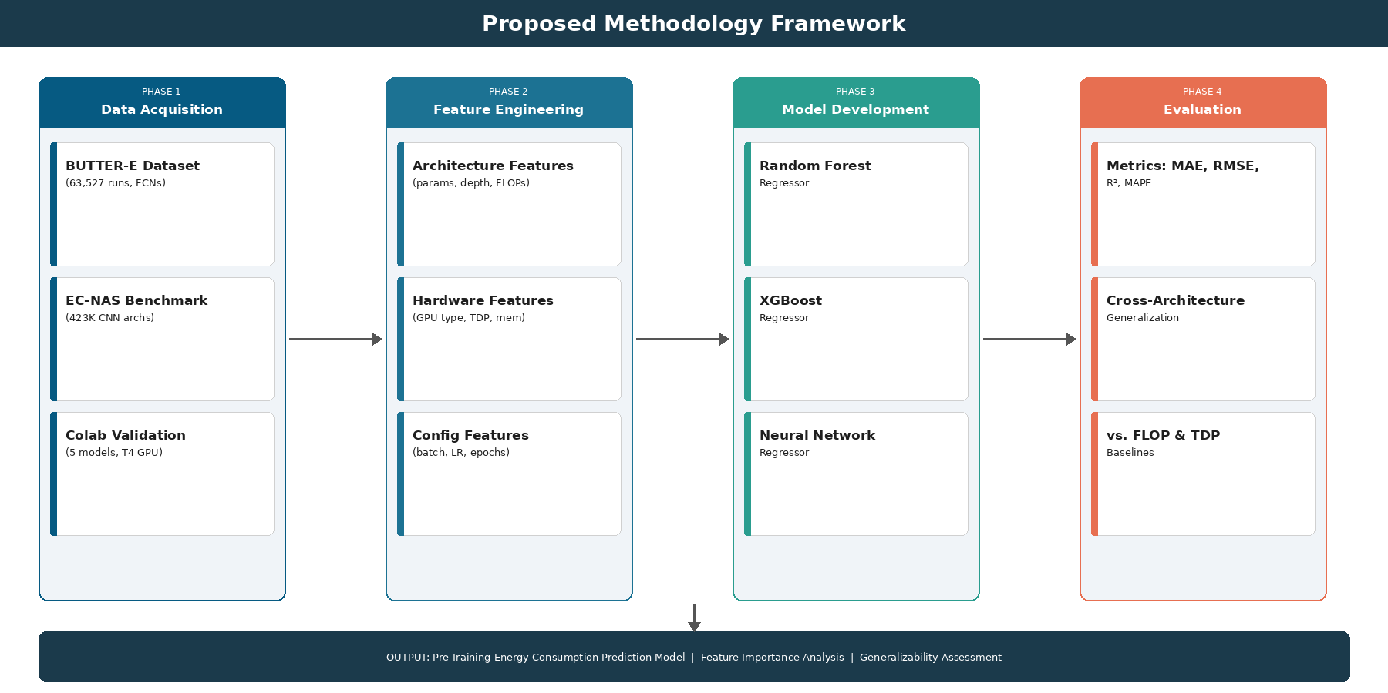
Methodology Framework

Slide 13
Data Sources
BUTTER-E Dataset
EC-NAS Benchmark
63,527 experimental runs
30,582 distinct configurations
Fully connected neural networks
Node-level watt-meter measurements
CPU (Intel Xeon) & GPU (V100)
13 datasets, 20 sizes, 8 shapes
Source: NREL Open Energy Data Initiative
~423,000 CNN architectures
Based on NAS-Bench-101
Convolutional neural networks
Energy, carbon, accuracy metrics
Trained on CIFAR-10
Graph-based architecture descriptions
Source: Bakhtiarifard et al. (2024)
Combined: 486,000+ configurations with real energy measurements — no new experiments required

Slide 14
Feature Engineering
Architecture Features
Hardware Features
Training Config
Trainable parameters
Network depth (layers)
Network width (max neurons)
Width-to-depth ratio
Estimated FLOPs
Layer type distribution
GPU type (categorical)
GPU memory capacity
Thermal Design Power
Memory bandwidth
Compute capability
Batch size
Learning rate
Dataset size (samples)
Number of epochs
Dataset dimensionality
Preprocessing: Standard scaling, one-hot encoding, log transformation of skewed features

Slide 15
Model Development & Evaluation
Random Forest
XGBoost
Neural Network
Ensemble of decision trees;
robust to scaling; provides
feature importance
Gradient boosting; strong
on tabular data; built-in
regularization
MLP with batch norm
and dropout; captures
complex interactions
Grid search CV
(n_estimators, max_depth)
Bayesian optimization
via Optuna
Architecture search
(2-5 layers, 64-512 width)
Analytical Baselines
Evaluation Metrics
FLOP-based: FLOPs × (TDP / throughput)
Linear scaling: f(params × epochs)
MAE | RMSE | R² | MAPE
80/10/10 split with stratification
Cross-architecture + leave-one-out HW tests

Slide 16
The Transferability Question
Can a model that learns energy patterns from MLPs also predict energy for CNNs — and vice versa?
Our Three Evaluation Protocols
Within-Architecture
Cross-Architecture
Combined Model
Train on 80% of BUTTER-E,
test on 20% of BUTTER-E.
Same for EC-NAS separately.
Baseline: “Can we predict energy
for the same type of network?”
Train on BUTTER-E (MLPs),
test on EC-NAS (CNNs).
And vice versa.
Novel test: “Do energy patterns
transfer across architecture types?”
Merge both datasets into one.
Train a unified predictor.
Ultimate question: “Can one model
work across all architectures?”
MLP → MLP | CNN → CNN
MLP → CNN | CNN → MLP
MLP + CNN → Any

Slide 17
Scope & Honest Limitations
What We Cover
What We Don’t Cover (Yet)
✓ MLPs (fully connected networks)
63,527 runs from BUTTER-E with real watt-meter data
✓ CNNs (convolutional networks)
423,000 architectures from EC-NAS benchmark
✓ CPU and GPU hardware
Intel Xeon CPUs and NVIDIA V100 GPUs
✓ Cross-architecture transfer testing
First study to test MLP ↔ CNN energy prediction transfer
✗ Transformers / LLMs
No large-scale energy benchmark exists for Transformers yet
✗ RNNs / LSTMs
Not included in either BUTTER-E or EC-NAS datasets
✗ Diverse GPU hardware
BUTTER-E uses V100; modern A100/H100 not represented
✗ Distributed / multi-GPU training
All runs are single-node; parallel training not tested
Why this scope is sufficient: MLPs and CNNs are the two most fundamental architecture families. If energy patterns transfer between these structurally different networks, it provides strong evidence that a universal predictor is feasible. This study is the necessary first step.

Slide 18
Expected Contributions
Feature Importance Analysis
Empirical identification of which architectural, hardware, and configuration features most strongly predict training energy consumption, using SHAP values and permutation importance.
Validated Prediction Framework
A trained ML model that can estimate energy consumption before training begins, validated across fully connected and convolutional architectures on real watt-meter data.
ML vs. Analytical Comparison
Quantitative evidence on whether data-driven approaches outperform FLOP-based and TDP-based analytical methods for energy prediction.
Practical Tool for Green AI
A reproducible, open-source framework that enables resource-constrained researchers to make energy-aware decisions about model training.

Slide 19
Conclusion & Next Steps
This research addresses a critical gap in sustainable AI by developing a framework to predict neural network training energy consumption before training begins.
By leveraging 486,000+ real energy measurements from BUTTER-E and EC-NAS, the study avoids expensive new experiments while building cross-architecture predictive models.
The outcome is a practical tool that enables researchers — especially those in resource-constrained settings — to make informed, energy-aware decisions about model training.
Thank You
Questions & Discussion

